Slide 1
10min RDS Breach Scenario
DigitalForensic Track 김태룡

Slide 2
○●○○○○○○○○○○○○○
INDEX
01. RDS
02. Scenario
2-1 Build
2-2 Attack
2-3 Detection
03. Remediate
RDS Breach Scenario

Slide 3




○○●○○○○○○○○○○○○
RDS
Relational Database Service
RDS Breach Scenario

Slide 4
○○○●○○○○○○○○○○○
RDS
Relational Database Service
RDS Breach Scenario

Slide 5









○○○○●○○○○○○○○○○
RDS
VPC#2
VPC#1
Lambda
API Gateway
RDS Breach Scenario

Slide 6
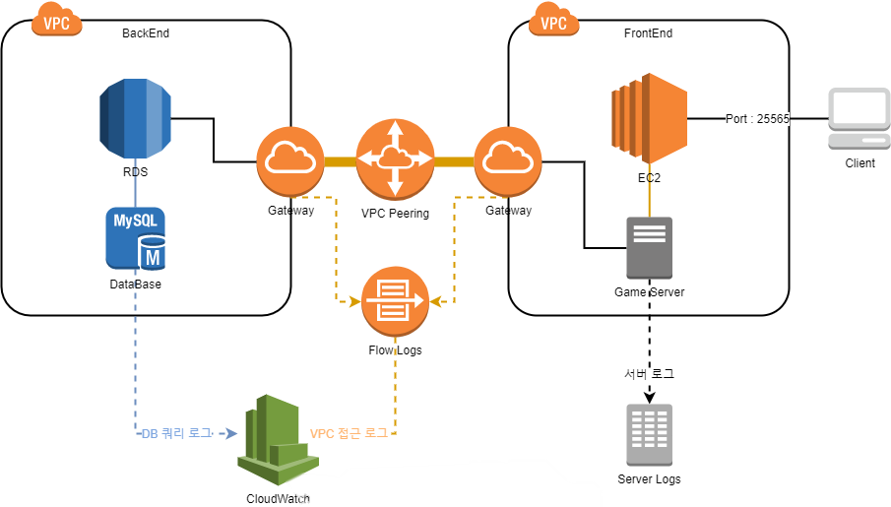
○○○○○●○○○○○○○○○
Scenario
Build
RDS Breach Scenario

Slide 7
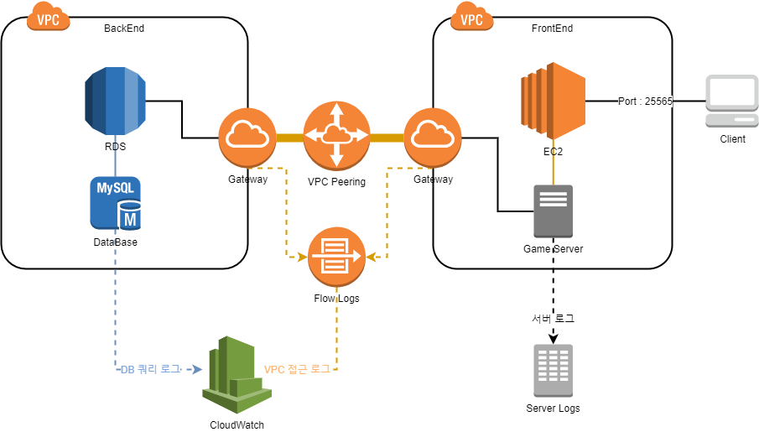
○○○○○○●○○○○○○○○
Scenario
Build
+ Economy System
RDS Breach Scenario

Slide 8
○○○○○○○●○○○○○○○
Scenario
Build
+ Command Execute
+ Economy System
RDS Breach Scenario

Slide 9
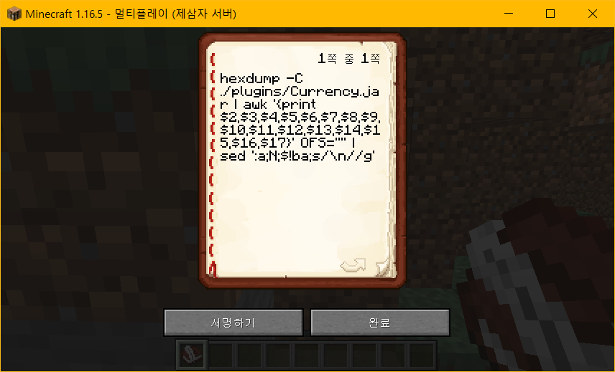
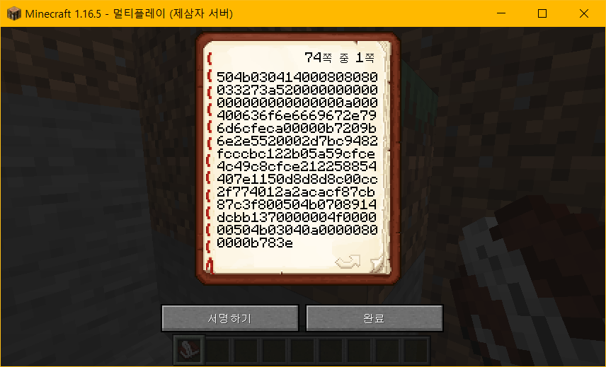
○○○○○○○○●○○○○○○
Scenario
Attack
RDS Breach Scenario

Slide 10
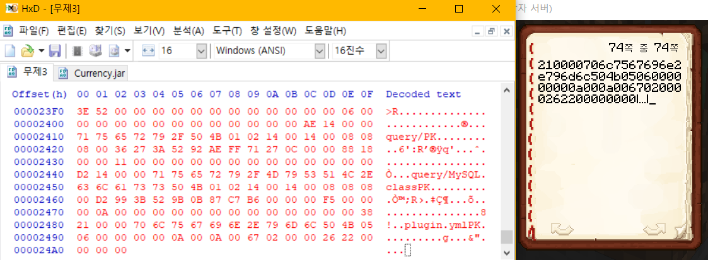
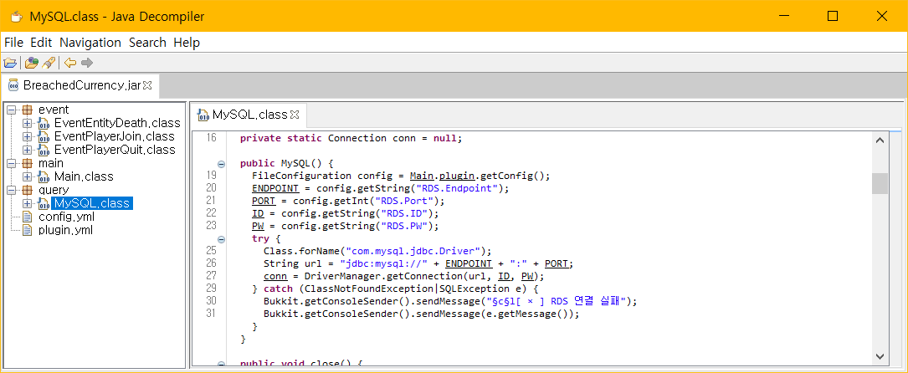
○○○○○○○○○●○○○○○
Scenario
Attack
RDS Breach Scenario

Slide 11
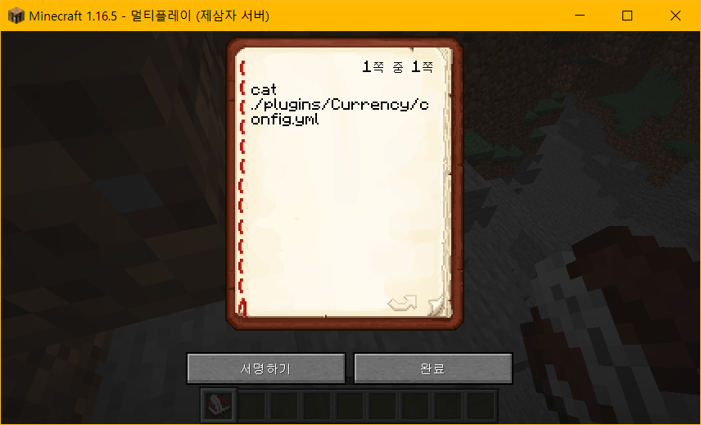
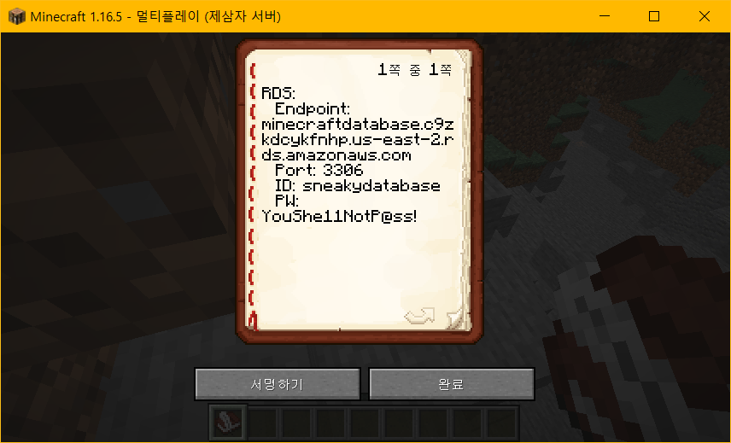
○○○○○○○○○○●○○○○
Scenario
Attack
RDS Breach Scenario

Slide 12
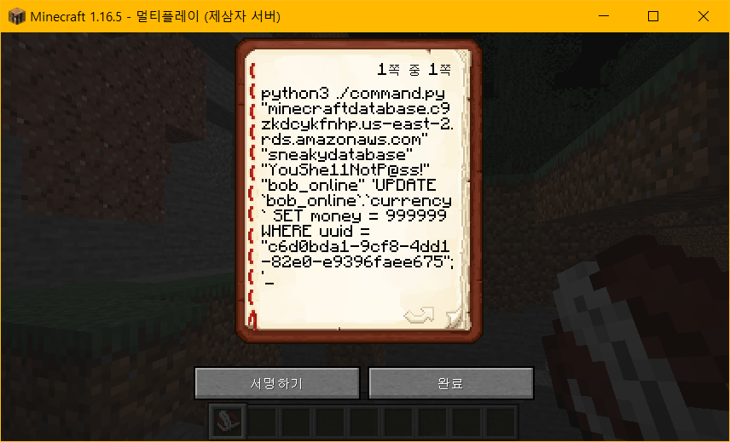
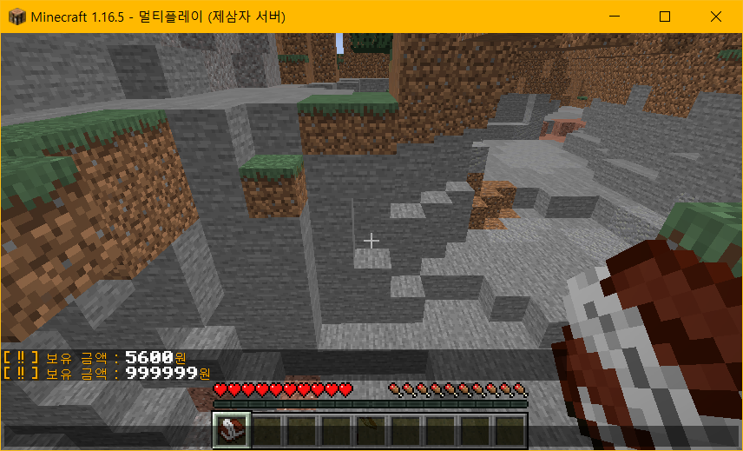
○○○○○○○○○○○●○○○
Scenario
Attack
RDS Breach Scenario

Slide 13
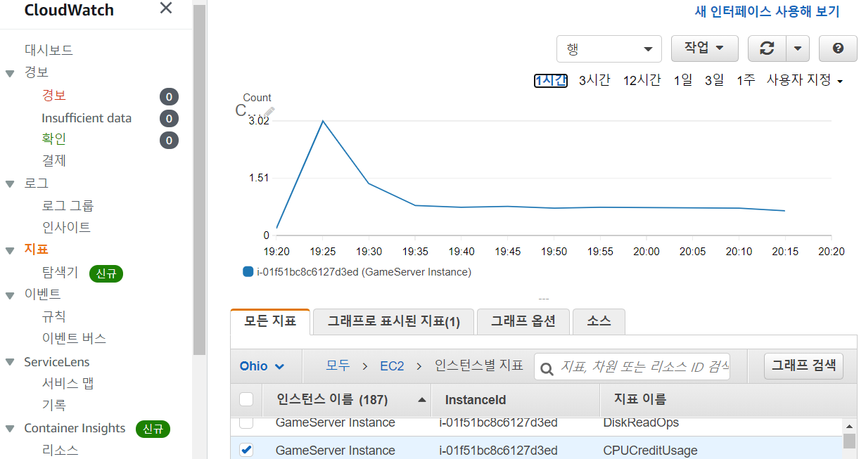
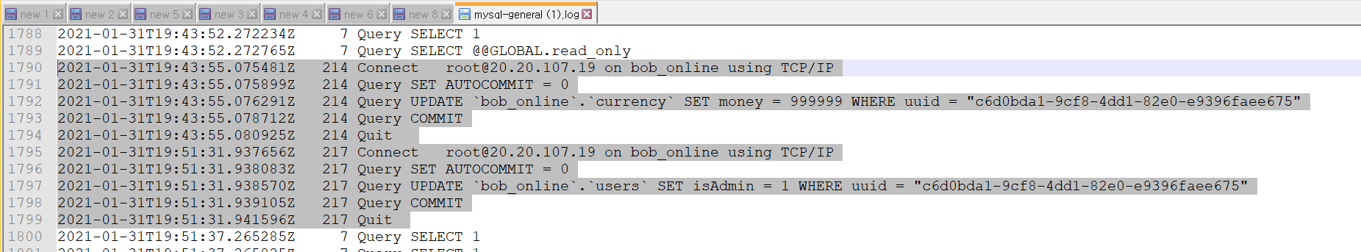

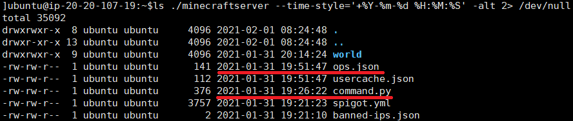

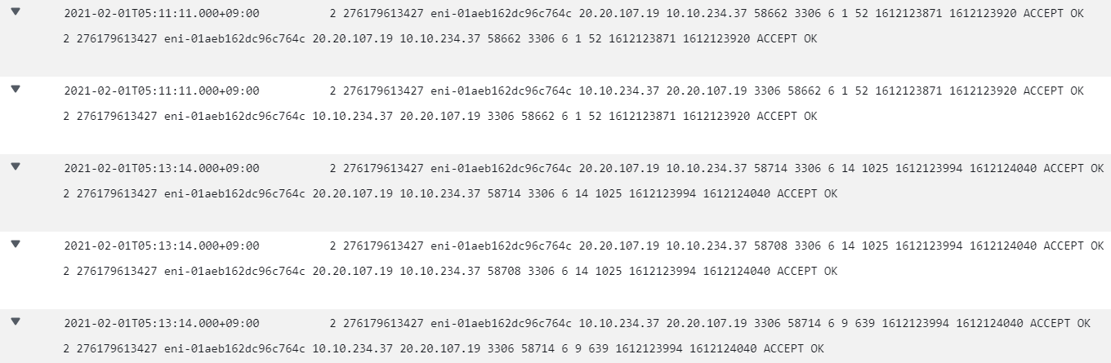
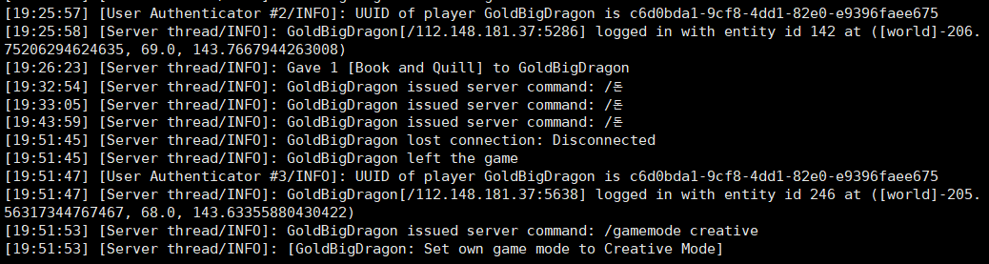
○○○○○○○○○○○○●○○
Scenario
Detection
RDS
General.log
Cloud Watch
Indicators
EC2
Server Logs
Server Directory
Cloud Trail
Logs
RDS Breach Scenario

Slide 14
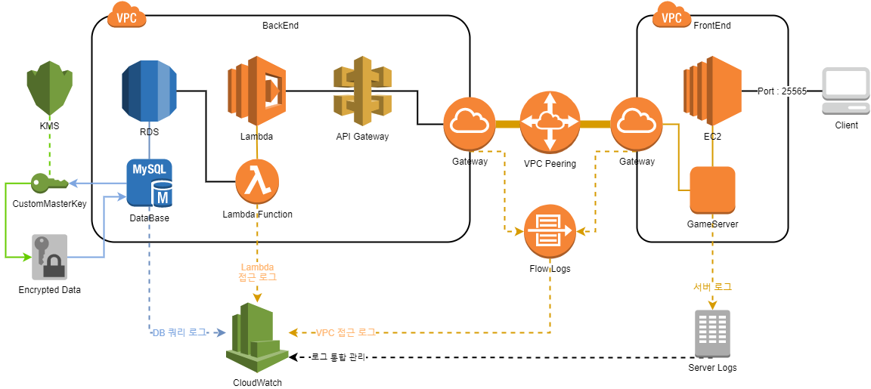
○○○○○○○○○○○○○●○
Remediate
RDS Breach Scenario

Slide 15
Thankyou

